Slide 1
Online examination SYSTEM
Mohammed Latif Siddiq,1505069
Nadia Anjum,1505085

Slide 2
OBJECTIVEs
Centralized Examination
A platform for practice, examination and discussion
A system for taking examination without any large physical space
Automatic ranking and result publishing
Reduce time consumption

Slide 3
Description
Online examination system is a platform where anyone can participate in exams from anywhere. This software will ease the exam system as neither the teacher or the students must be present physically for attending the examination. This will save both time and cost. Moreover students will be highly benefitted from the discussions and this will make quality education available to everyone.
*what is discussion: teachers can post elaborate explanations on particular topics. Students can participate in the discussion by commenting. They can ask for help for better understanding via this media.
* Registration system: Usually to be admitted to an institute, one has to pay the fees in person or has to stand in a long queue in bank. In our reg system, we are using electronic payment media like bkash, upay etc for payment. This system will reduce the valuable time which was being wated by standing in lines for payments.

Slide 4
Short coming
Cheating may occur
Setup wrong questions or no answer for the questions
Some solutions may be written type and have to check manually

Slide 5
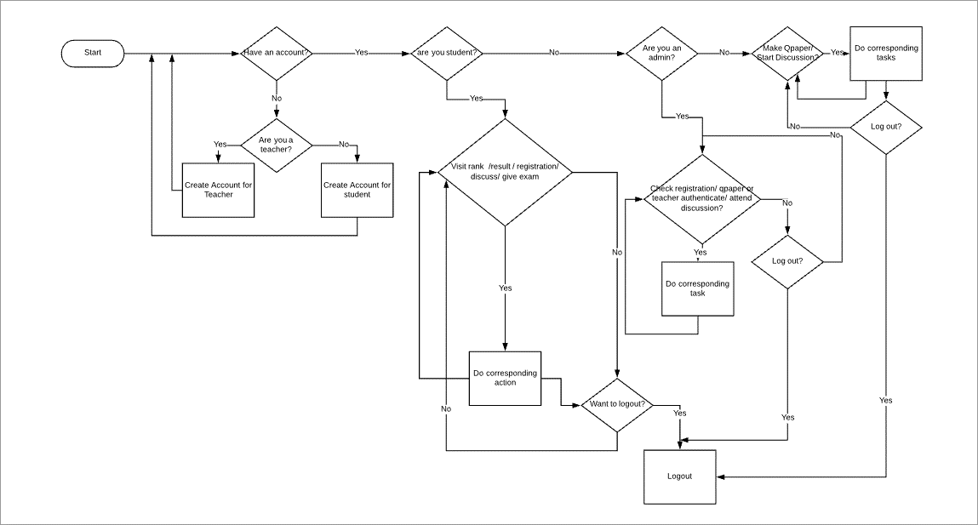
Flow chart

Slide 6
Requirement description
Signup and Log in system
Registration for examination
Discussion /blog posting
System for practice and paid examination
Result and rank list display
Question setup and verification

Slide 7
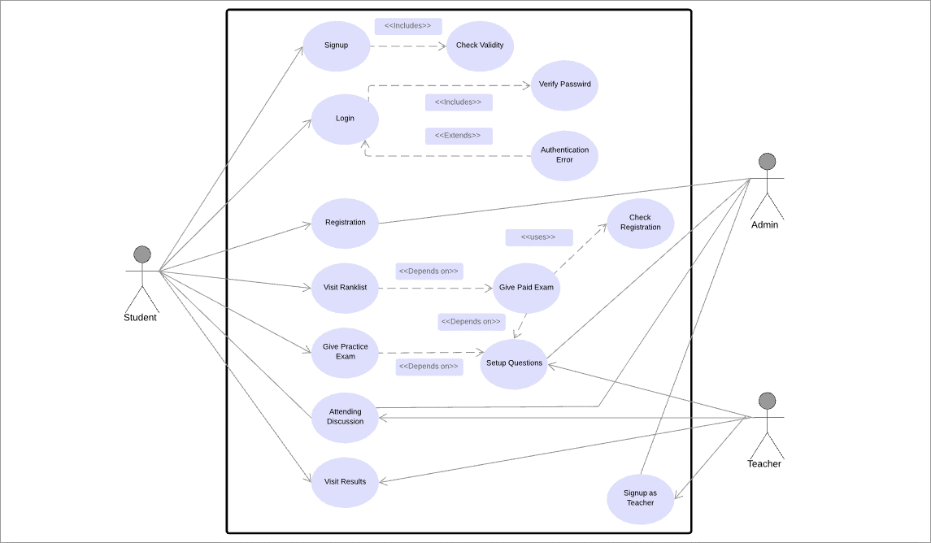
Use case DIAGRAM

Slide 8
Thank you

